Slide 1
Project Idea

Slide 2
Causes of accidents
Over speeding
Hard breaking
Distraction
Weather condition
Road condition
Mechanical failure

Slide 3
Distractions
Texting
Dialing
Talking or listening
Reaching for objects

Slide 4
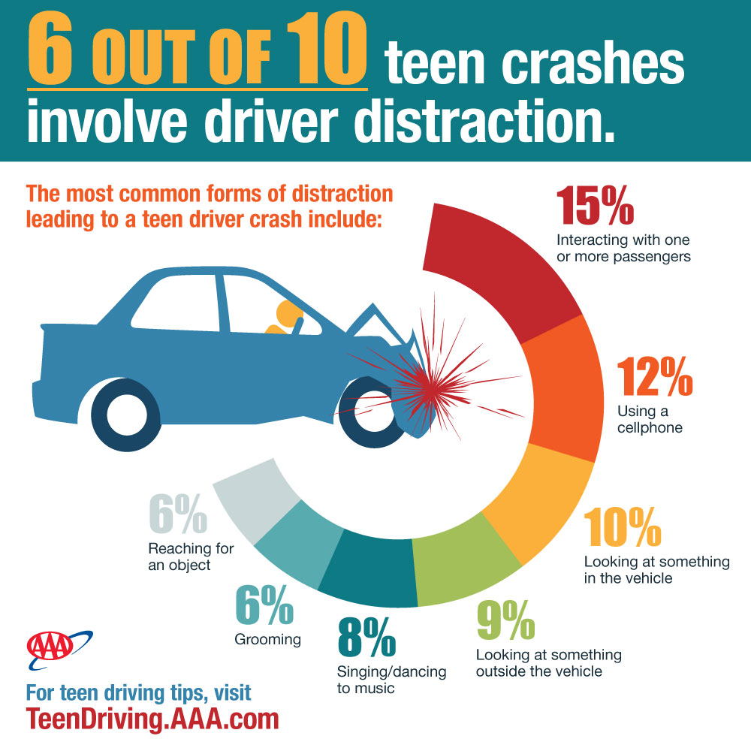
Statistics
330,000 injuries per year
1 out of 4 accidents are caused by texting while driving
Texting while driving is 6x more likely to cause an accident than driving drunk.

Slide 5
Texting and Driving
Average distraction time during texting
5 second

Slide 6
Idea
System for identifying drivers distraction

Slide 7
Challenges
Driving related activities vs distractions
  Manual car
  Open/close the window
  Showing indicator
  Using wiper

Slide 8
Thank you

